Slide 1

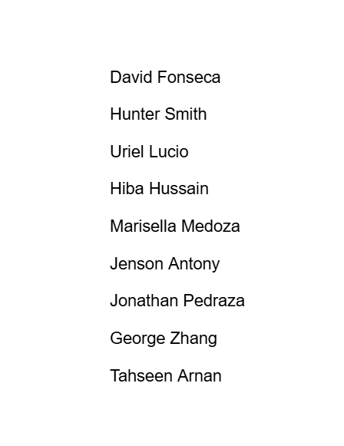
HOSPITAL MANAGEMENT SYSTEM
4y55

Slide 2

objective
Our objective with this project is to create a robust and easily scalable hospital management website.
Our project will implement the following feature set:
Login and Authorization for Patients and Doctors
Appointment booking for Patients
Appointment booking for Doctors
Medical Record-keeping for Doctors and Staff
A professional frontend website for ease of use
Backend databases to store relevant data

Slide 3
COST, EFFORT, and PRICING ESTIMATION
We will use Application Composition for cost estimation.
Estimates of application points:
User Authentication: 1 screen, 1 report, all simple = 3
Profile and Personal Information: 2 screens,1 report, all simple = 4
Scheduling: 2 screens, 2 reports, all simple = 6
Patient Medical Information and Doctor Notes: 2 screens, 2 reports = 6
Patient/Doctor communication: 1 screen, 1 report = 3
Billing and Payment: 1 screen, 1 report = 3
Management: 3 screens = 3
Security: 1 report = 2
Total NAP: 3+4+6+6+3+3+3+2 = 30
Estimated number of developers: 5, very low experience. PROD = 4
Assumed reuse%: 20%.
Thus, PM = NAP*(1 – reuse%/100)/PROD = 30*(4/5)/4 = 6 Person-Months
6/5 = 1.2 Months

Slide 4
ESTIMATED COST (hardware)
Server costs
Estimated size of data center: 500 square feet
Costs for a small data center: $800,000-$2,000,000
Server Racks: $1,500 per 42U rack
Servers: $3,000 per server unit
Wiring costs
Electrical Installment: $28,000-$70,000
Backup Generator: $15,000
Network cable/fiber optic cost: $500-$1,000 per data point
Ongoing costs
Labor costs: $50-$150 per hour
Electricity: $150 per kW/month
Internet: $80 per/month
Additional costs
Permits, inspections, and troubleshooting: $1,000-$5,000

Slide 5
ESTIMATED COST (software)
Core Software Costs:
Licensed software package: $50,000 - $100,000
Software with Customization: $100,000 - $250,000
Additional Software Costs:
Implementation: $20,000-$50,000
Annual Maintenance: 15% – 20% of initial investment per year
Infrastructure:
Cloud Hosting: $1,000 - $3,000
Estimated Total Cost:
Initial Investment: $100,000 - $250,000
Annual Operating Cost: $10,000 - $50,000 for costs outside of personnel salaries

Slide 6
ESTIMATED COST (Personnel)
Frontend Developer:
$112,039 yearly
Backend Developer:
$158,331 yearly
DevOps Engineer(s):
$125,908 yearly
Maintenance (Six-month duration):
Calculated at 12% of development costs.
Estimated at $39,627.80
Training Cost (Six-month duration):
A one-time cost of $5,000
Project Management (Six-month duration):
Estimated at $112,039
Total Costs for Five Developers over Six Months:
Estimated at $817,130.15

Slide 7
Project TIMELINE
09/20/2024 admin.py complete
09/27/2024 app.py complete
10/4/2024 models.py and urls.py complete
10/10/2024 forms.py and views.py complete
10/16/2024 tests.py complete

Slide 8

Functional requirements
Registering Page: Patients will have the ability to register on the website and create a personal account to keep in the system.
Log-in and Account Information Retrieval: After registering patients shall have the ability to go to our login page and securely login with an authentication method. After logging in patients will be able to view their accounts and information including personal and medical information.
Homepage: One of the key pages of the website will provide patients with an overview of the hospital, offering quick and easy access to all fundamental services and information
Doctor and Department Pages: Patients will be able to explore a directory of hospital departments and doctors, each with its own page on our website. The doctor directory will give patients detailed info, such as their licenses, specialties, qualifications, availability, and contact details. The department page will showcase all the areas our hospital specializes in, offering patients clear and specific information about each one.
Appointment Page: Patients will be able to easily book appointments with a doctor of their choice.
Contact Us Page: Website will feature a page where patients can find contact details for hospital administration and support staff, along with the addresses of our facilities.

Slide 9

Non-functional requirements

Slide 10
Product Requirements
Efficiency: Helps the website load quickly for booking and information retrieval.
Dependability: Maintain reliable uptime, minimizing disruptions.
Usability: Design an intuitive interface for easy navigation.
Performance: Optimize response time, especially for medical data.
Space: Manage storage effectively, especially for medical data.

Slide 11
Organizational Requirements
Consider
Environmental: Consider compatibility with hospital IT systems.
Integrate
Operational: Integrate with existing hospital management software.
Adhere
Development: Adhere to industry best practices for maintainability.

Slide 12
External Requirements
Regulatory: Comply with healthcare regulations like HIPAA.
Ethical: Respect patient consent for data use.
Legislative: Meet legal data protection standards.
Accounting: Support secure, accurate financial transactions.
Safety/Security: Protect against unauthorized access.

Slide 13
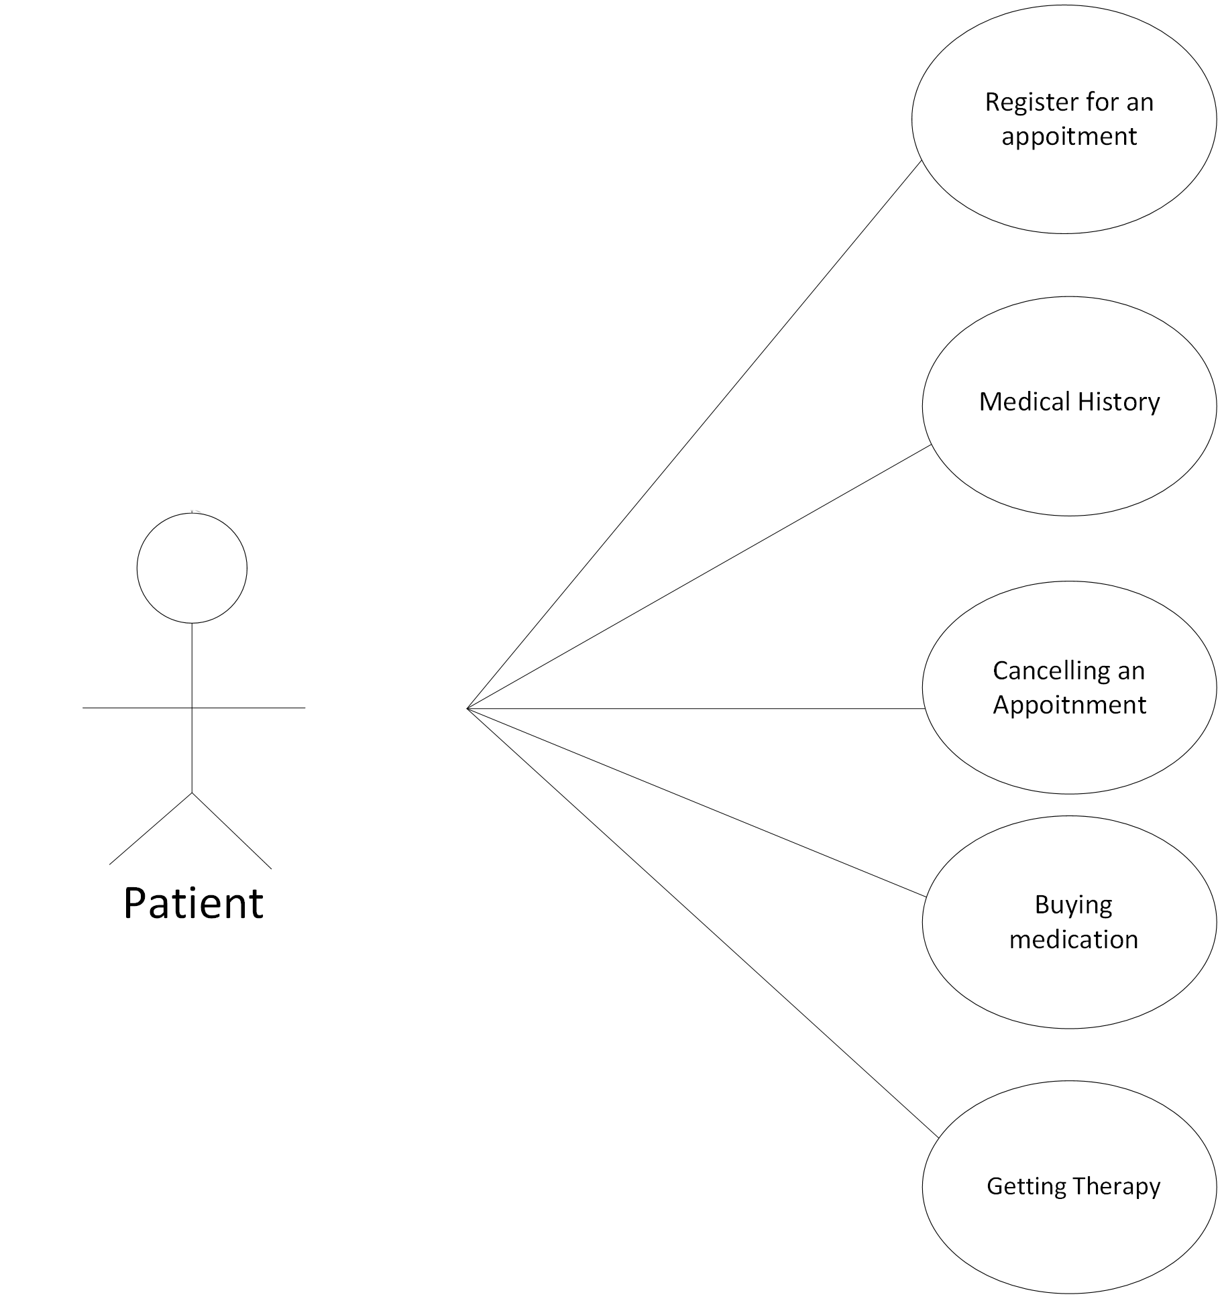
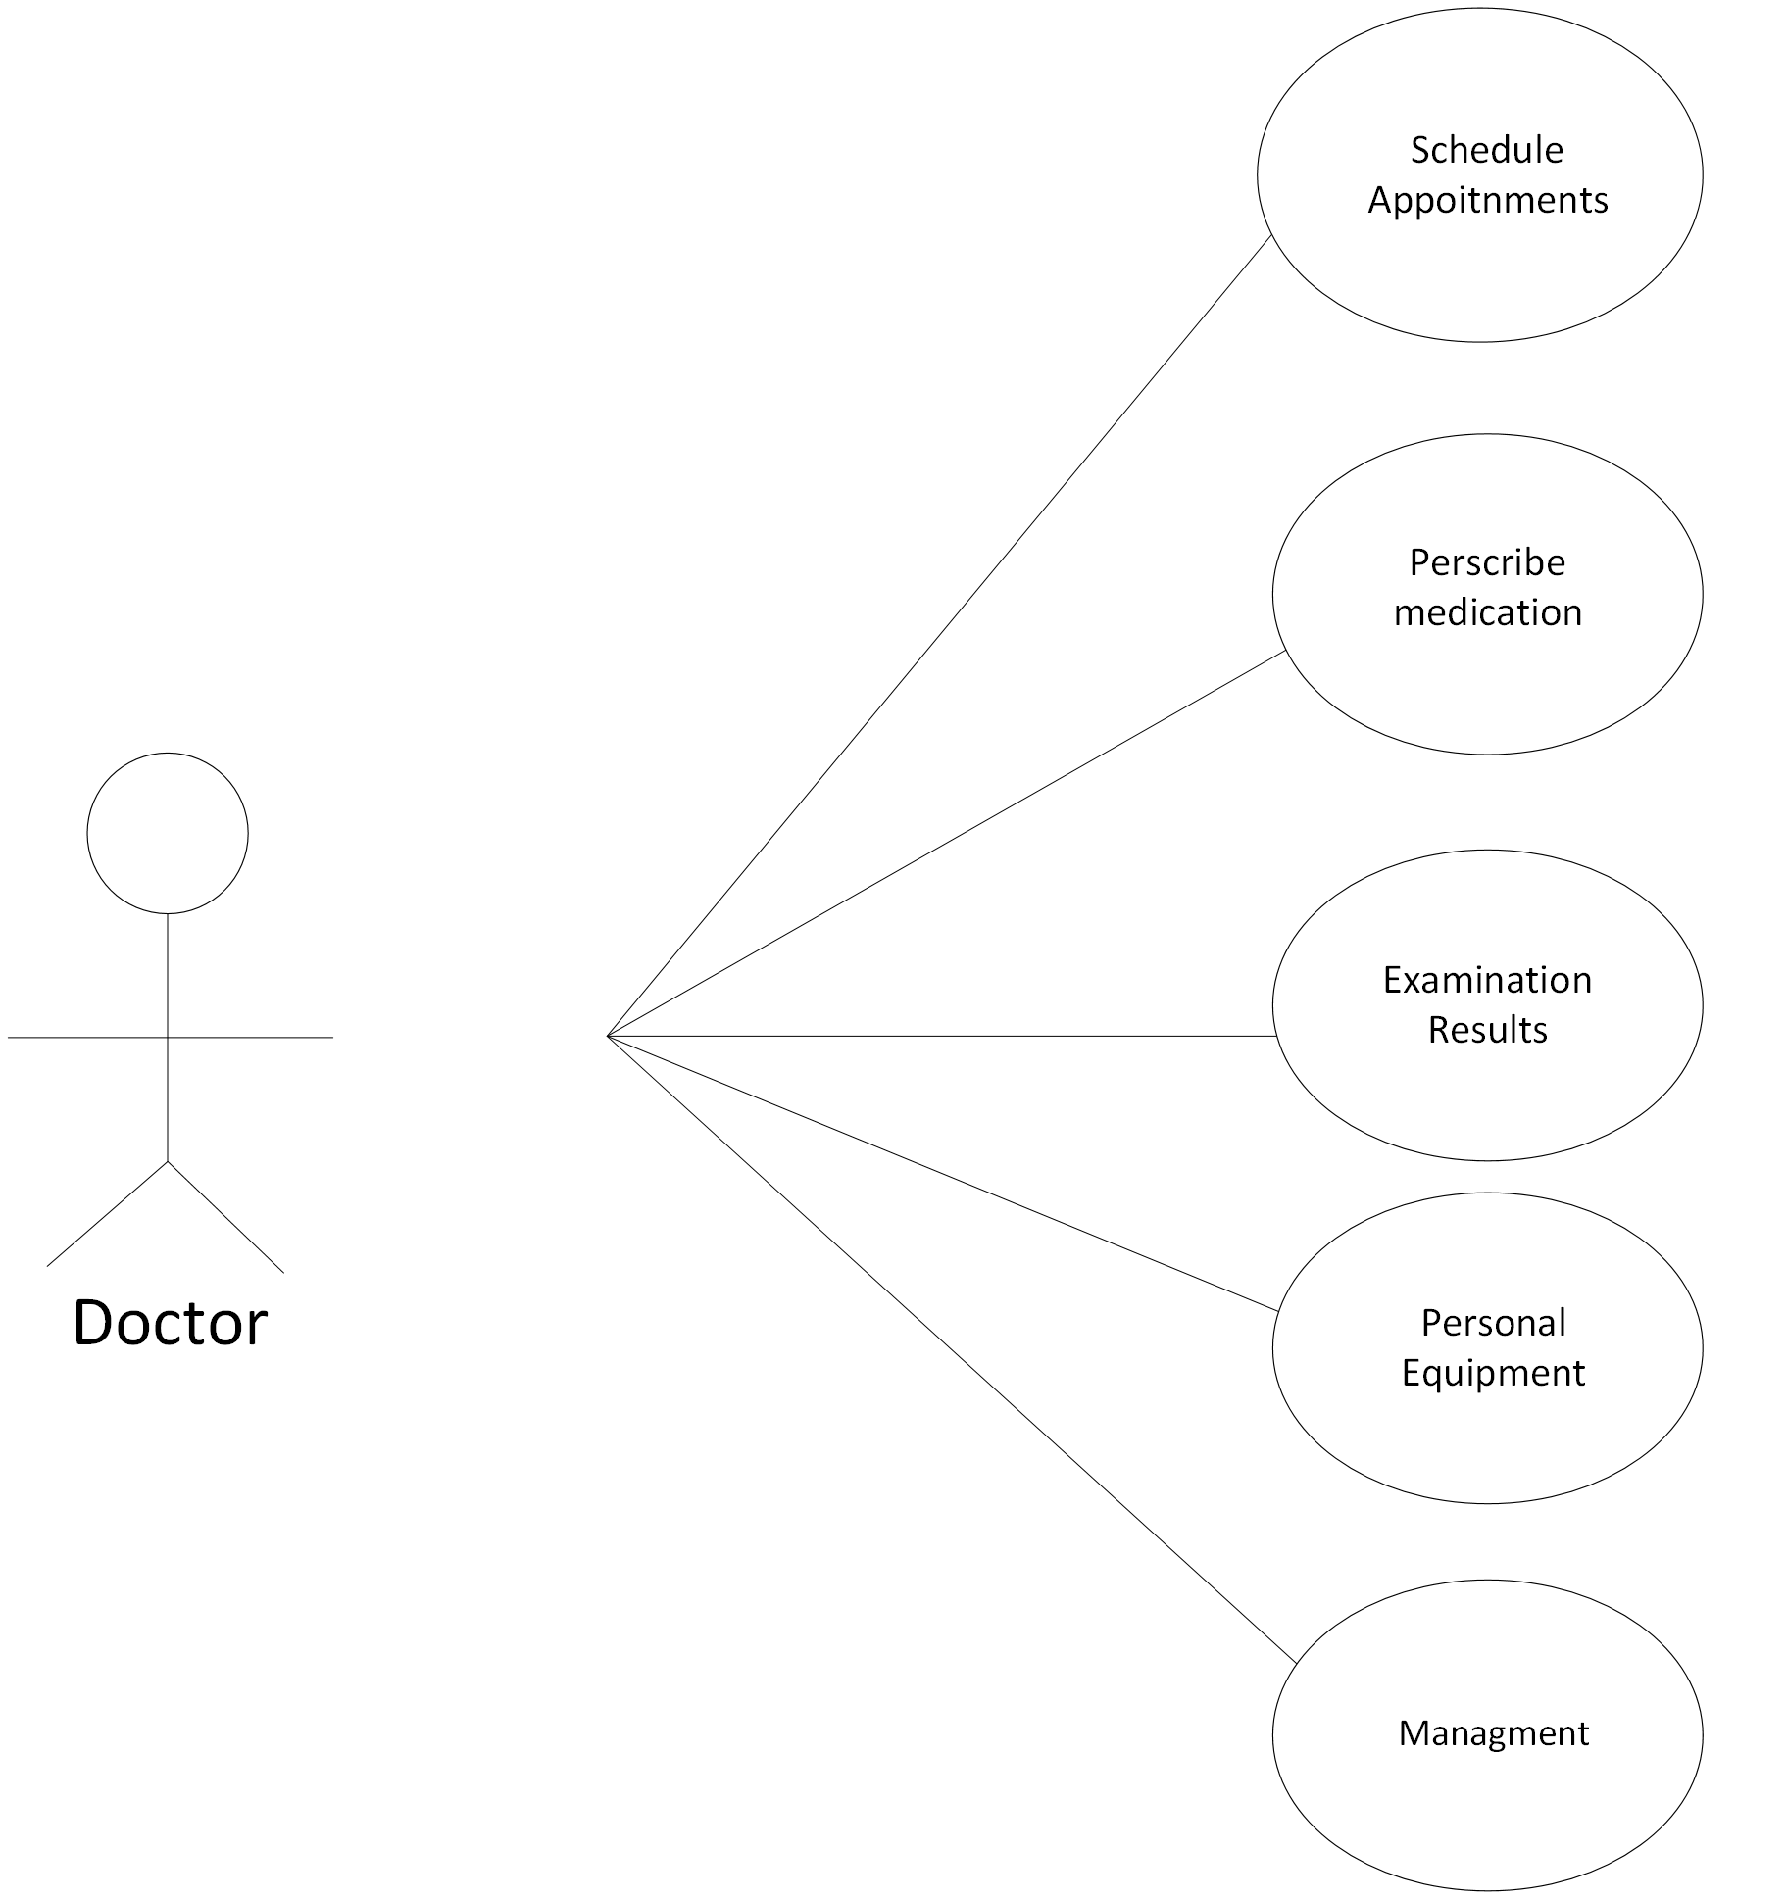
CASE DIAGRAM FOR DIFFERENT USERS
Patient
Doctor

Slide 14
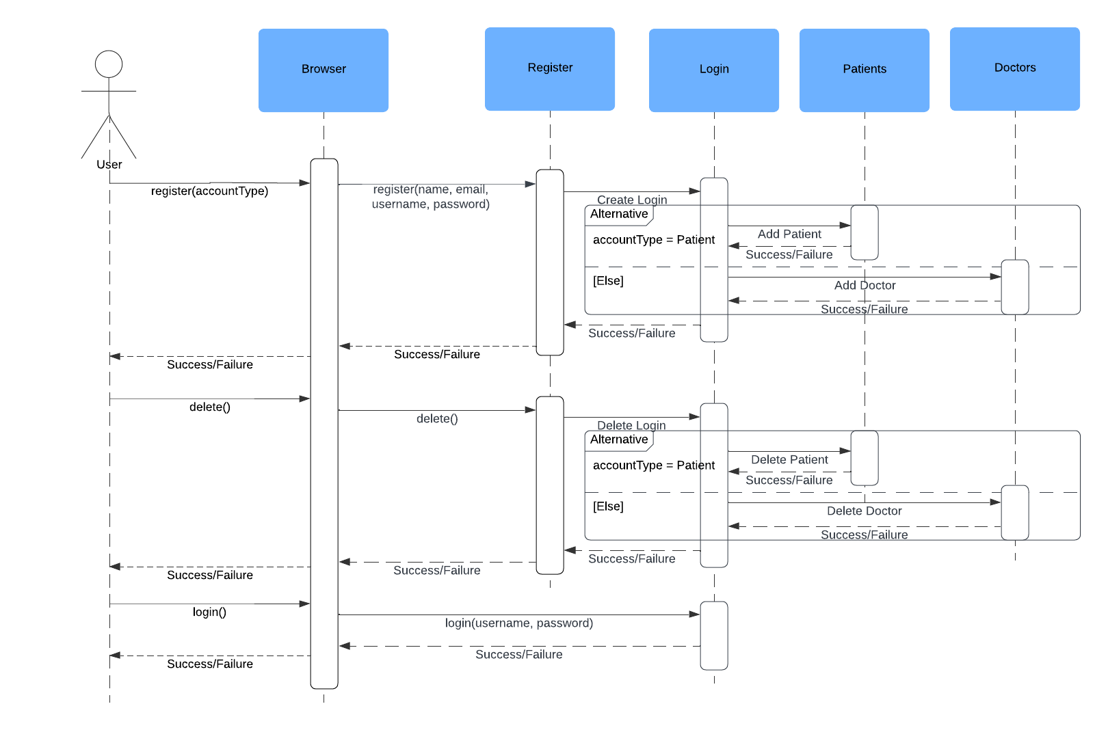
Sequence Diagram for Account Management

Slide 15
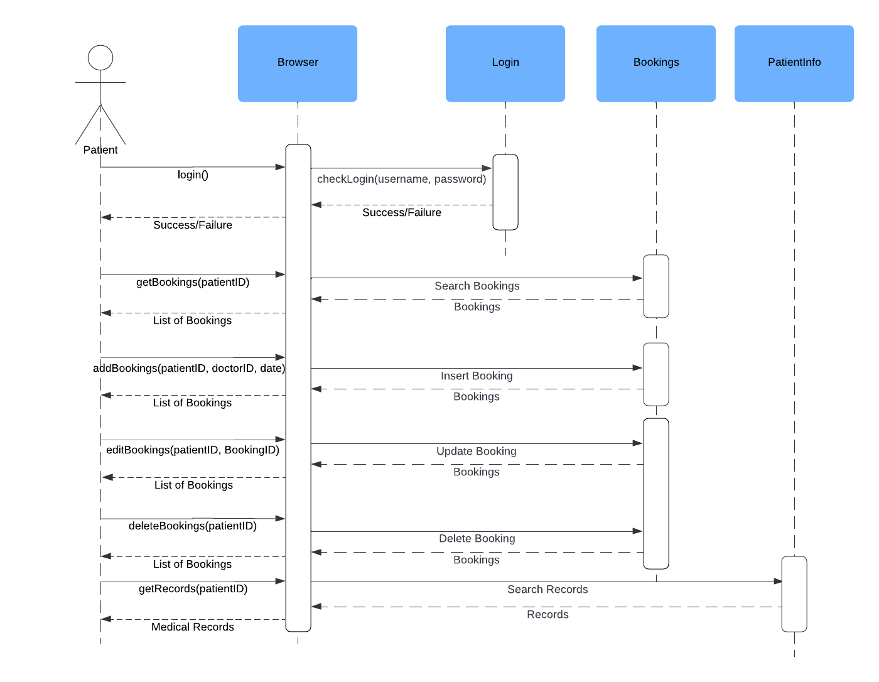
Sequence Diagram for Patient Bookings

Slide 16
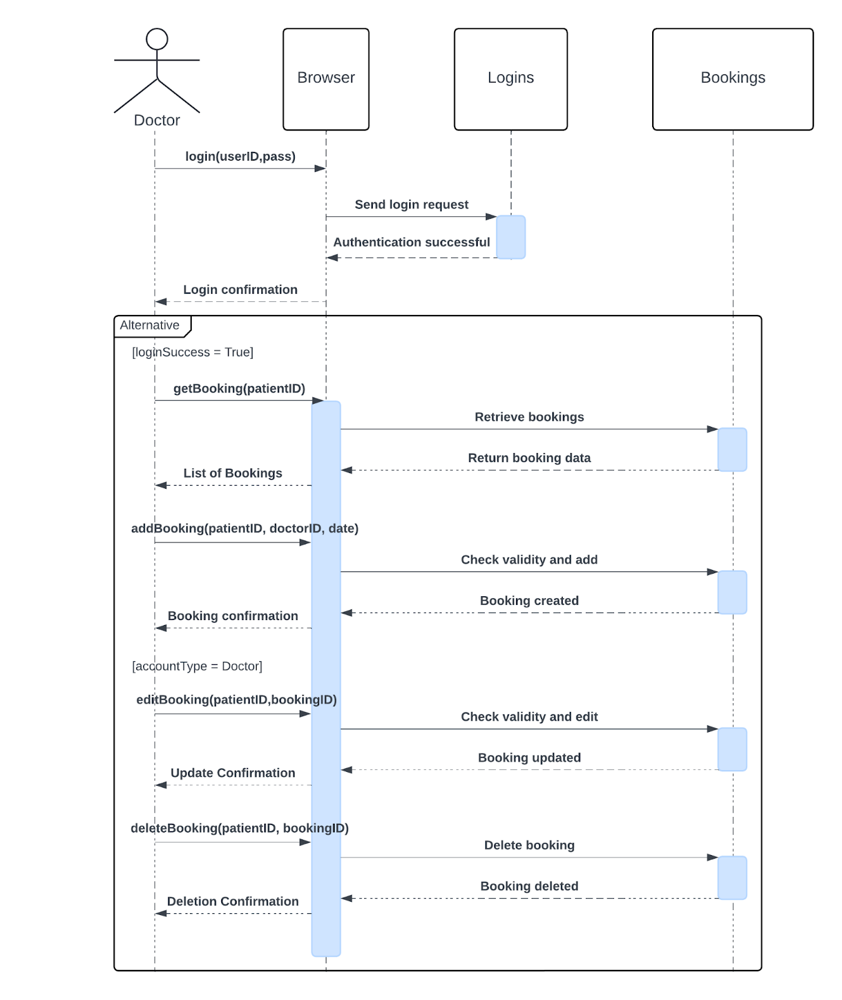
Sequence Diagram for Doctor Bookings

Slide 17
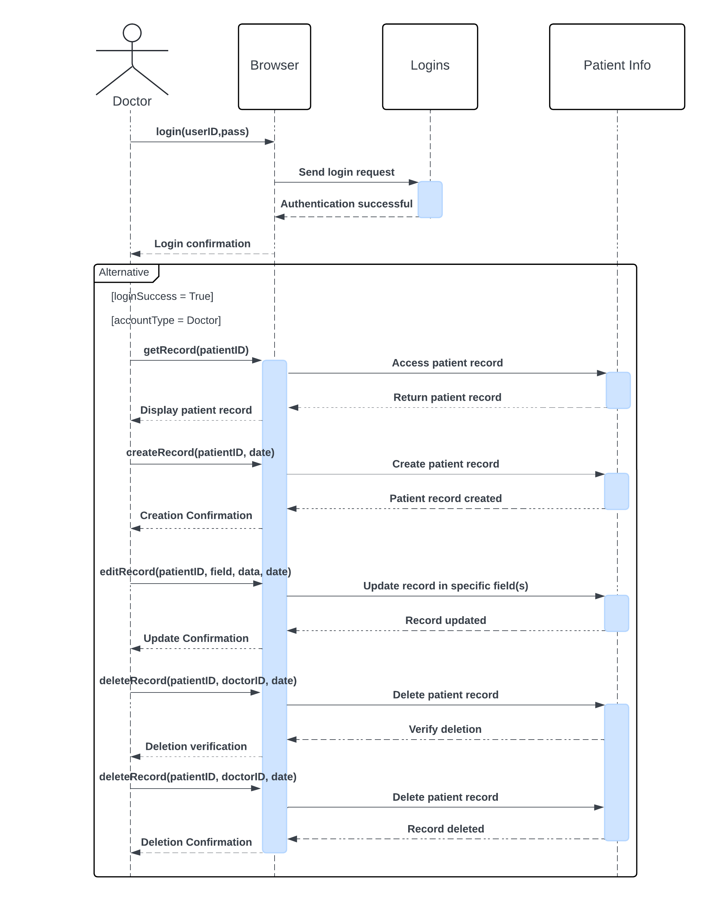
Sequence Diagram for MEDICAL RECORDS

Slide 18
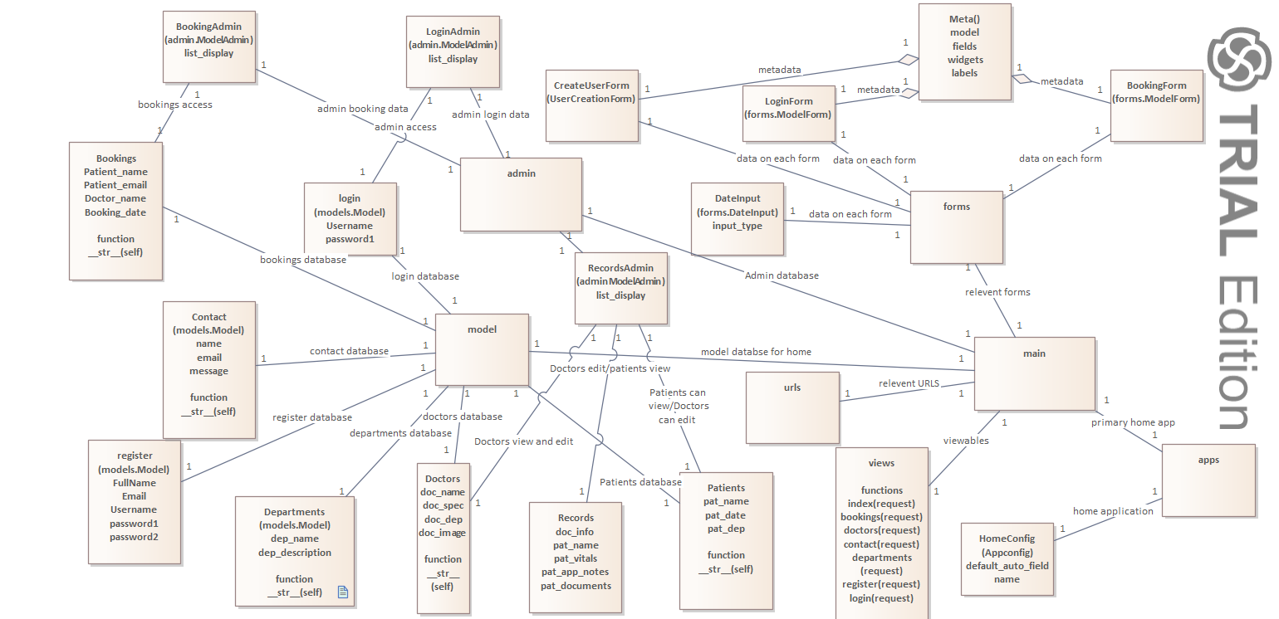
Class diagram

Slide 19
Home
Home connections
Apps
Forms
Admin
URLS
Model
Views

Slide 20
forms
Forms connections
CreateUserForm
BookingForm
LoginForm
These three are all connected to the metadata class
DateInput

Slide 21
Apps
Apps connections
HomeConfig

Slide 22
admin
Admin connections
BookingAdmin
LoginAdmin
RecordsAdmin

Slide 23
URLS
URLS
Contains all relevant URLS

Slide 24
Model
Model connections
Contact
Departments
Doctors
Bookings
Register
Login
Patients

Slide 25
Views
Views
Contains all the viewable classes and calls them

Slide 26

Model–view–controller
Architectural Design​

Slide 27
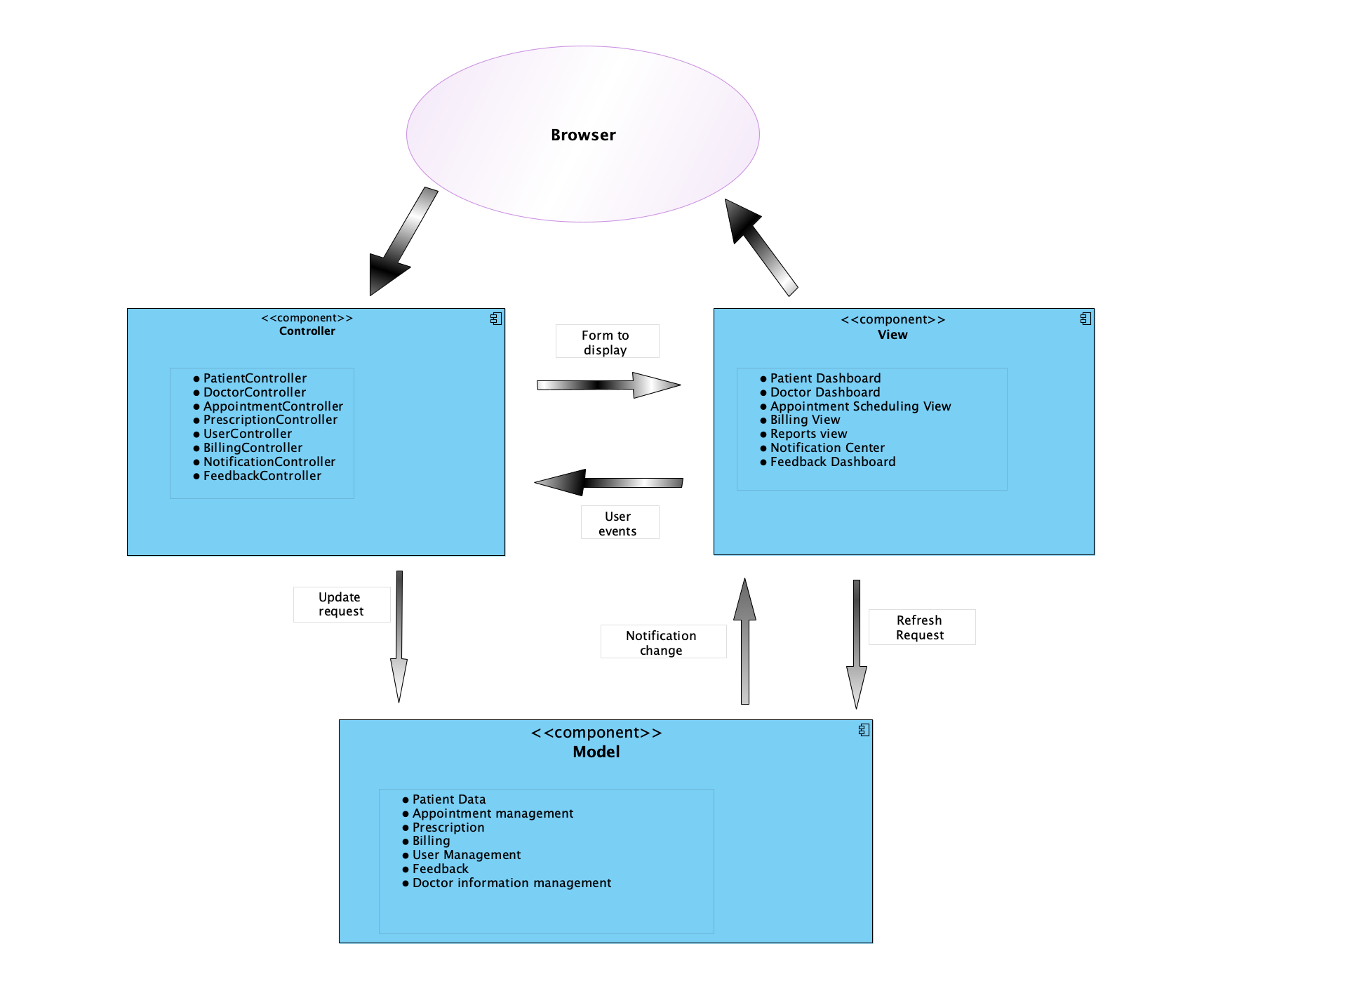

Slide 28
Data and Logic
Data Storage: Uses a relational database to store data reliably.
Business Logic: Implements rules, such as ensuring a doctor isn’t double-booked, or handling patient billing calculations.
This Model handles Create, Read, Update, and Delete operations on the data, which are critical for a system where patient data must be updated regularly.
Incorporate validation and role-based access at this level to ensure data integrity and security.

Slide 29
User Interface
User Groups and Interfaces
Doctors: Access patient records, schedules, and medical histories.
Patients: View their own records, upcoming appointments, and billing details.
Hospital Admins: Access all data, including staff and inventory.
Ensures the application is accessible on various devices, crucial for a hospital setting where users may access the system from desktops, tablets, or mobile devices.

Slide 30

Controller and Logic Processor
Input Processing: It validates inputs (e.g., ensuring appointment times are within hospital hours).
Data Communication: Pulls or updates data through the Model and ensures the View reflects the latest data.

Slide 31

Data Flow
User Action: Patient submits a request to schedule an appointment.
Controller Processing: Validates the request, checks the doctor’s schedule.
Update: Adds the appointment record in the database.
Feedback to User: Displays a confirmation message.

Slide 32
Benefits of Model view controller
Each component operates independently, simplifying maintenance.
Teams can work on the backend and frontend simultaneously
New features and requirements can be easily added to the model.

Slide 33
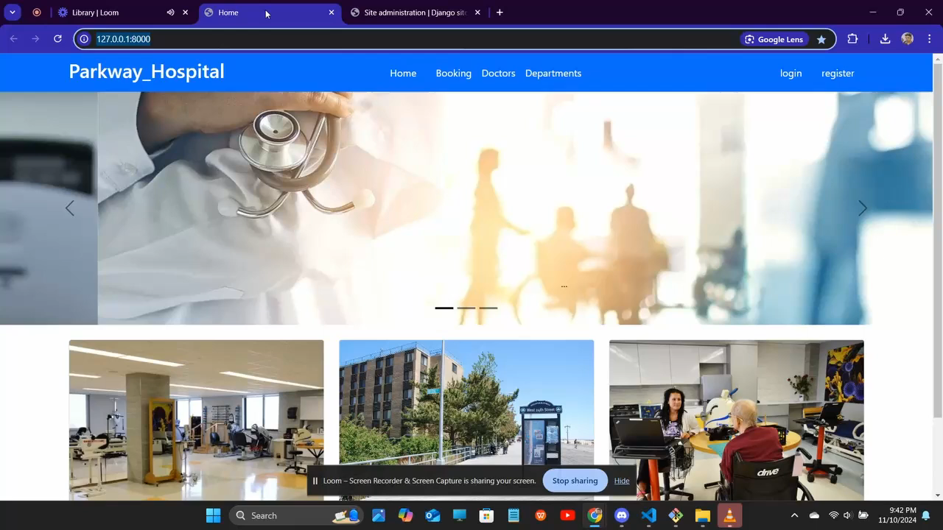
Project demo

Slide 34

Thank you!

